Slide 1

Batch Machine Learning
By: Minnie Cherry Chua Tan
Supervisor: Victor Miranda
May 26, 2022

Slide 2
Introduction
2022
AI is forecast to reach $62.5B at a CAGR of 21.3%
2025
the global AI market is expected to be around $60B, while the unmet clinical demand of AI industry outlook is $390B.
2030
global GDP will grow $15.7T due to AI
Notes:
with demand for skills of programming, libraries and frameworks, mathematics and statistics, machine learning and deep learning, natural language processing and computer vision, data science and data analysis, Alexa skills demand in US is 66K

Slide 3
Objective
To provide a tool minimize user interaction and/or development
To have saveable retrievable results of statistical metrices and/or graphs archived by name, date, time
To use hyper-tuning using GridSearchCV and/or other optimal method whenever applicable.
To do some deep learnings like ANN, CNN, RNN to handle image, text processing and other unsupervised learnings like SOM, RBM.
Notes:
by creating a usable tool for user to add or update only input files to execute instead of scripts that produced graphs and excel metrices with minimal customization or development required

Slide 4
Software usage
1
Input Files
Config.json
input_*.txt
2
Execute Programs
Output Files
3

Slide 5
Software Tool Architecture
Application Layer
main
Input.txt
Config.json
Domain Abstraction Layer
preprocessor
model
Programming Paradigm Layer
regression
Programming Language Layer
classification
cluster
rules
sampling
neural
nonsupervised
constant
Helper

Slide 6
Machine Learning Technology Used
Scikit-learn
Preprocess
Build Model
Train
Predict
Results: Statistics / Graphs
Tensorflow (Deep Learning)
Preprocess
Build Model
Compile Model
Train
Predict
Evaluate
Results: Statistics / Graphs
Notes:
torch for RBM

Slide 7
Tool Setup
1
Go to the directory
cd <directory>/my_practice_v2
2
Install pipenv
pip install pipenv
3
Install the project
pipenv install
4
Execute the program
pipenv run python –W ignore main.py –i <input_*.txt>

Slide 8

Example Tool Execution python –W ignore main.py -i <input*.txt>
Regression – input_regression.txt
Classification – input_classifier.txt
Cluster – input_cluster.txt
Rules – input_rules.txt
Text – input_text.txt
Sample – input_sample.txt
Neural Network – input_neural_network.txt
Unsupervised – input_unsupervised.txt

Slide 9
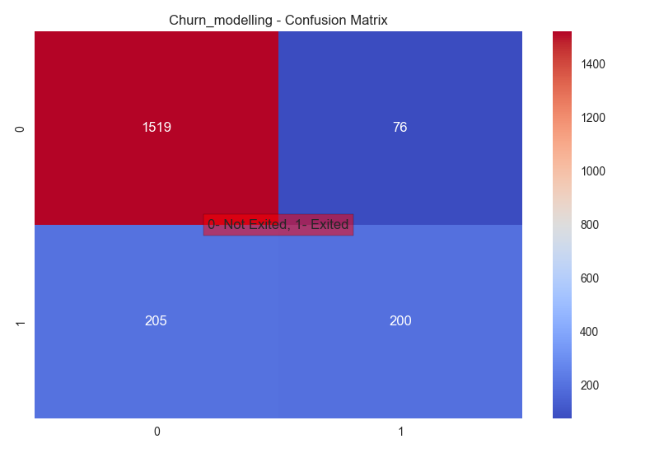
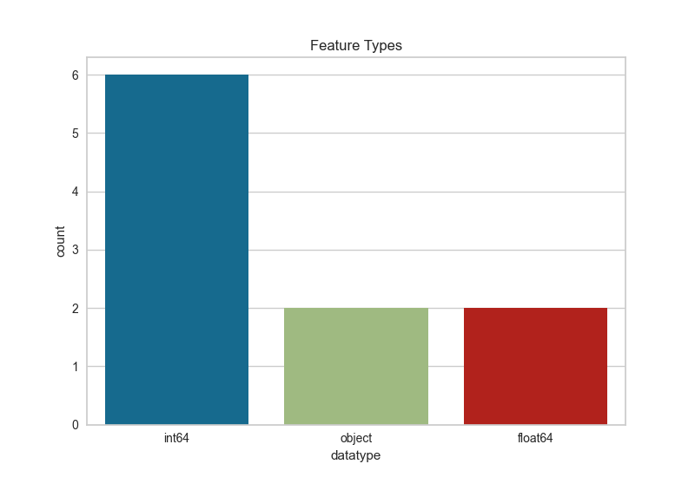
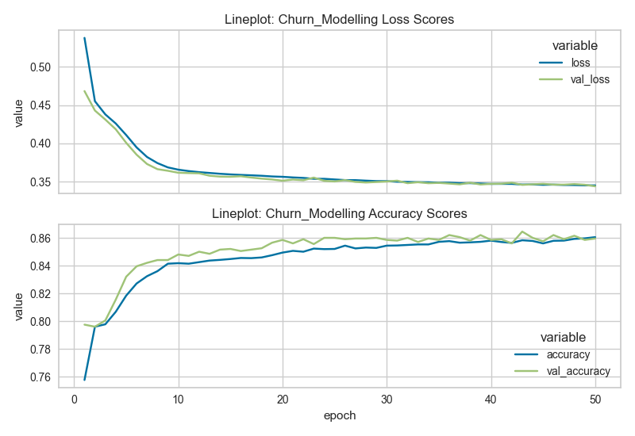
ANN Execution

Slide 10
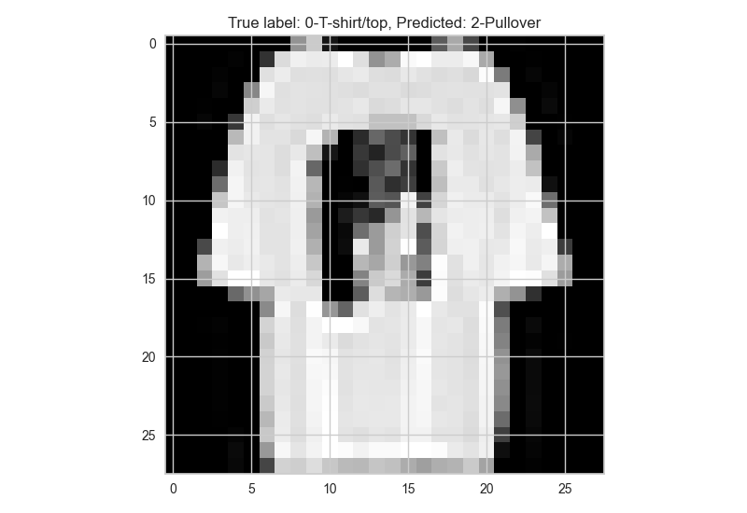
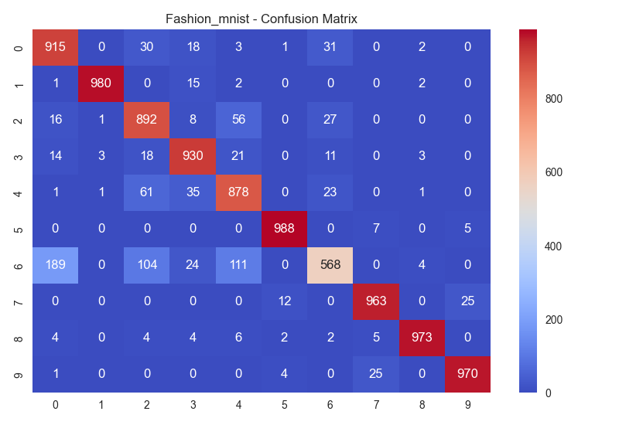
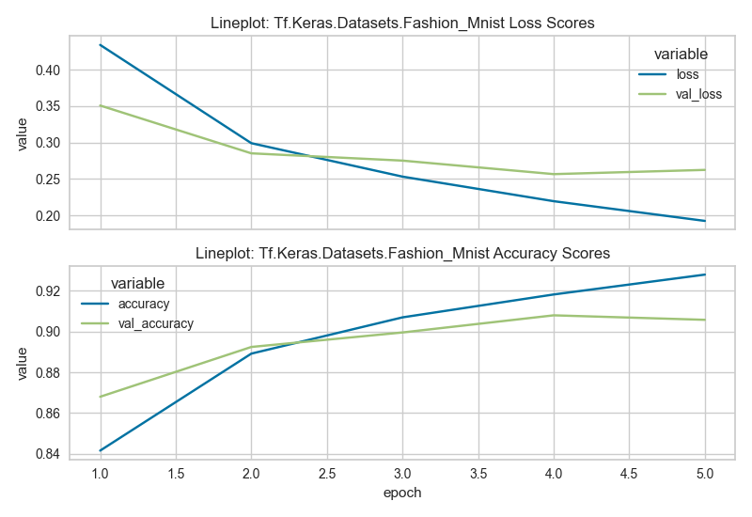
CNN Execution

Slide 11
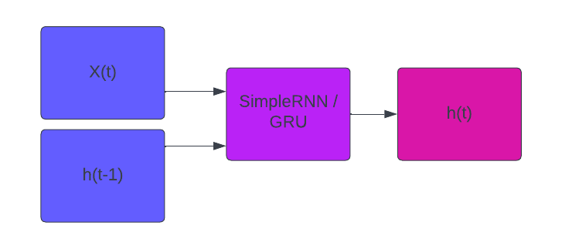
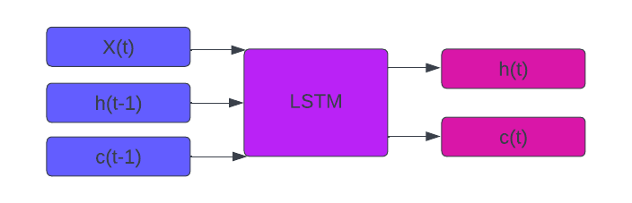



RNN
SimpleRNN / GRU
LSTM
SimpleRNN: $h_{t}=tanh⁡(w_{xh}^{T}x_{t}+w_{hh}^{T}h_{t−1}+b_{h})$
LSTM: $f_{t}=σ\left(w_{xf}^{T}x_{t}+w_{hf}^{T}h_{t−1}+b_{f}\right) (forget gate)$
$i_{t}=σ\left(w_{xi}^{T}x_{t}+w_{hi}^{T}h_{t−1}+b_{i}\right) (input gate)$
$o_{t}=σ\left(w_{xo}^{T}x_{t}+w_{ho}^{T}h_{t−1}+b_{o}\right) (output gate)$
$$c_{t}=f_{t}{∗c}_{t−1}+i_{t}∗f_{c}⁡(w_{xc}^{T}x_{t}+w_{hc}^{T}h_{t−1}+b_{h})$$
$h_{t}=o_{t}{∗f}_{h}$($c_{t}$)
GRU: $z_{t}=σ\left(w_{xz}^{T}x_{t}+w_{hz}^{T}h_{t−1}+b_{z}\right) (neuron)$
$r_{t}=σ\left(w_{xr}^{T}x_{t}+w_{hr}^{T}h_{t−1}+b_{r}\right) (reset gate)$
$$h_{t}=\left(1−z_{t}\right)h_{t−1}+z_{t}∗tanh⁡(w_{xh}^{T}x_{t}+(r_{t}∗w_{hh}^{T}h_{t−1})+b_{h})$$

Slide 12
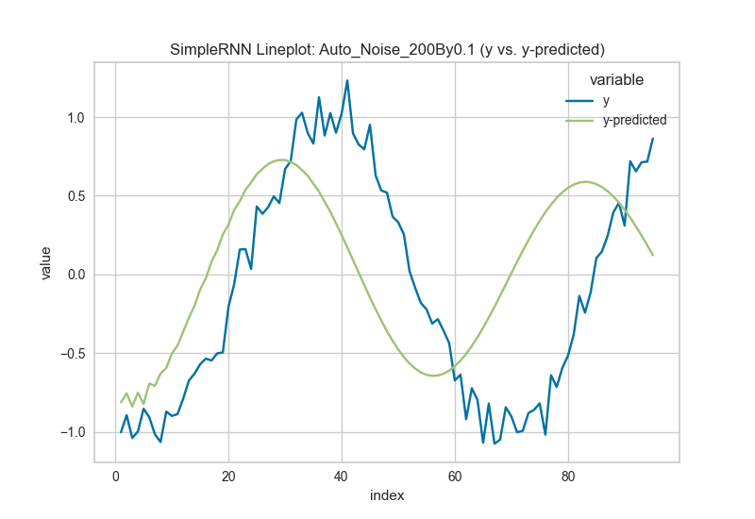
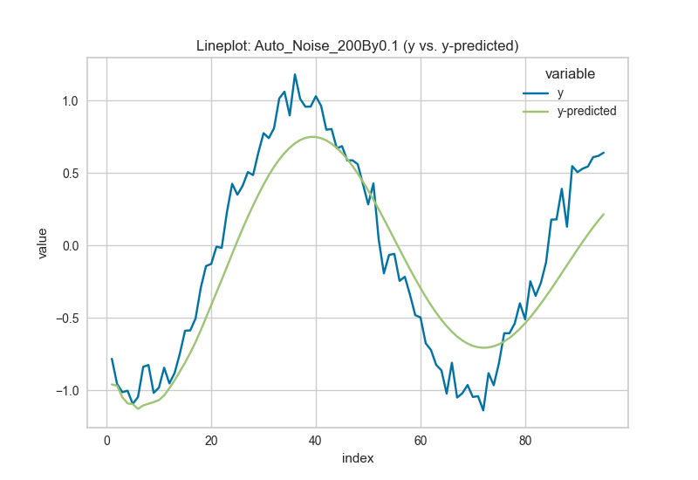
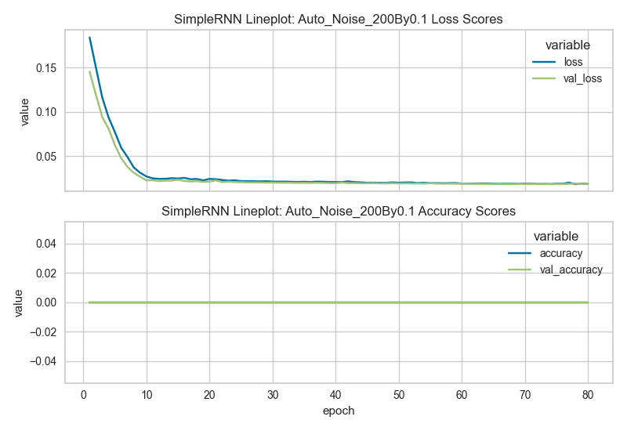
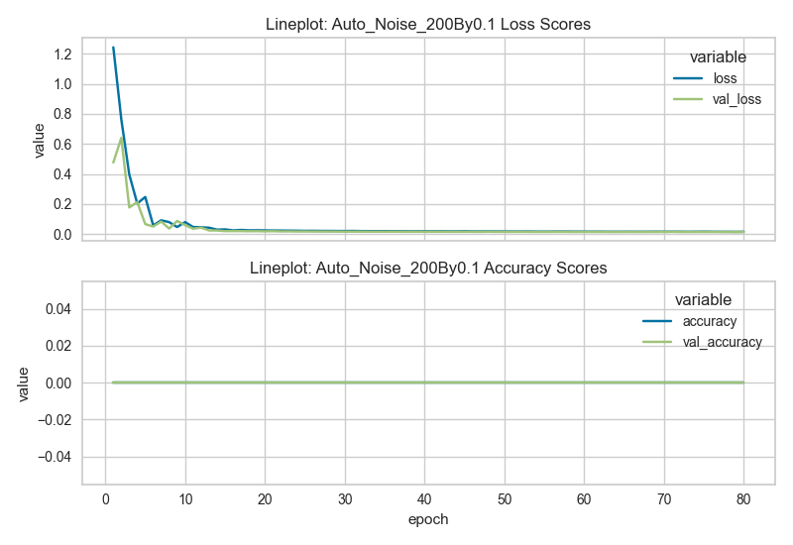
SimpleRNN
ANN

Slide 13
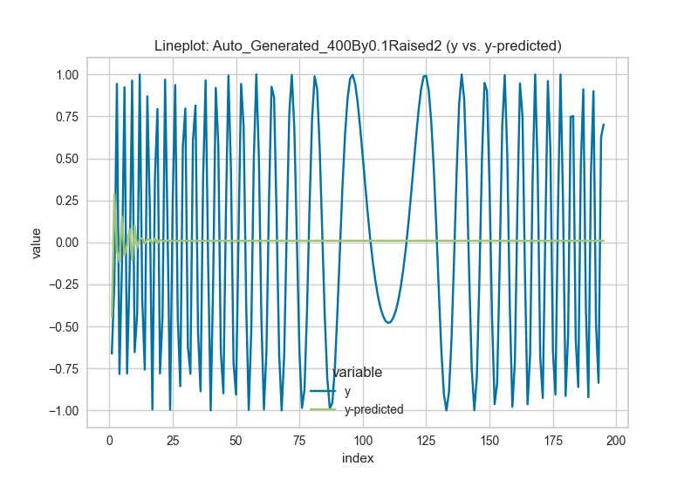
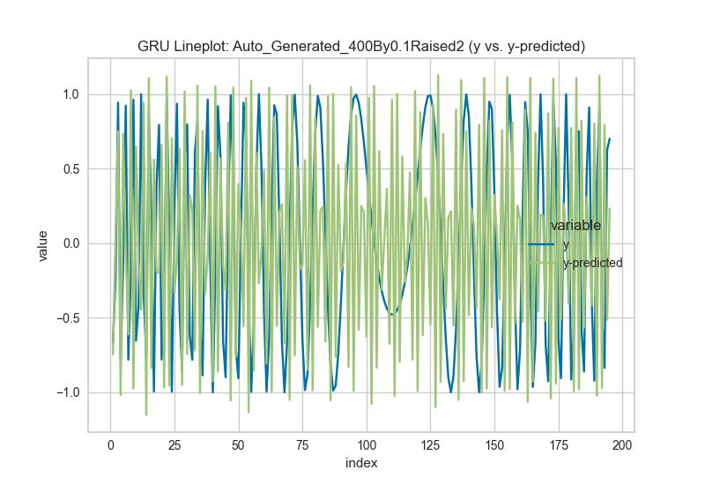
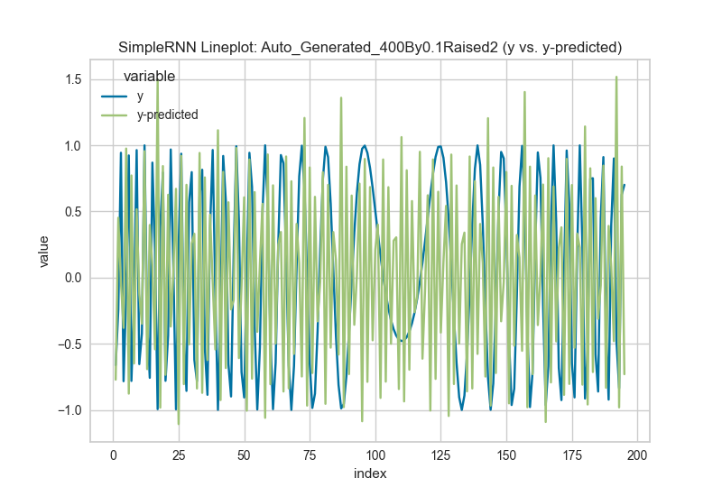
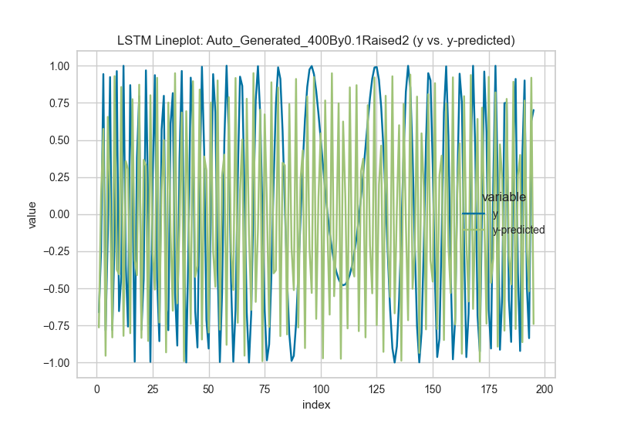
ANN
GRU
SimpleRNN
LSTM

Slide 14
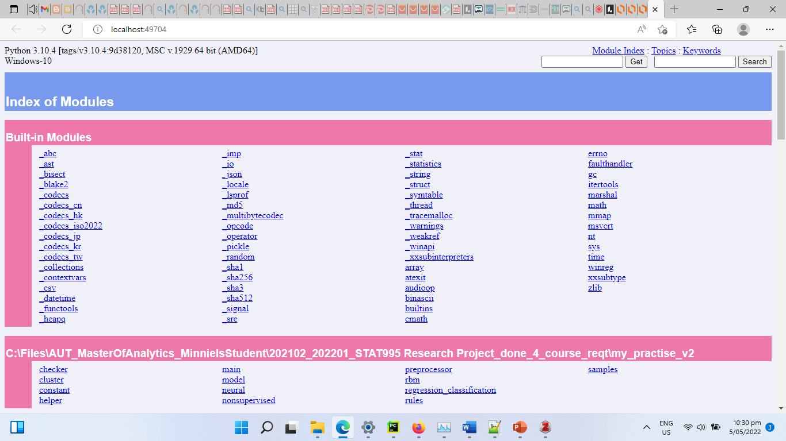
Extra: Online Documentation
python -m pydoc -b

Slide 15
Conclusion
Help minimize user interaction and minimal development required by input file setup
Traceable results of statistical metrices and/or graphs archived by name, date, time
Hyper-tuning is used normally for scikit-learn whenever applicable.
Deep learnings like ANN, CNN, RNN to handle image, text processing are present, with unsupervised learnings like SOM, RBM.
Notes:
by creating a usable tool for user to add or update only input files to execute instead of scripts that produced graphs and excel metrices with minimal customization or development required

Slide 16
Timeline
W1-W2
Prior weeks base version is created, document proposal, dynamic parser in the model
W3-W7
W8-W10
Added preprocessor, input files, and other modules constant.py, helper.py
W18-W21 (bit of summer)
Added model interfaces to have metrices, added regression, classification
W11-W17
Added cluster, rules, sampling, text processing, mid-project report
Added neural network: ANN,CNN, RNN-LSTM
W22-W25
Added unsupervised learnings of SOM, RBM
W26-W30
Added / updated RNN for SimpleRNN, GRU, LSTM, created final pptx

Slide 18


